Slide 1

Music Sentiment Classification
Λέανδρος Αθερίνης-Σπαρτιώτης mtn2301
Βικτωρία Πολυμεροπούλου mtn2314
Πουλιανού Χάιδω mtn 2327

Slide 2
Δομή της Παρουσίασης
Επιλογή Dataset
Labeling
Feature Extraction
Model fit on original dataset
Oversampling
Feature Selection
Kfold
Model Comparison & Results

Slide 3
Επιλογή του Dataset
DEAM dataset - The MediaEval Database for Emotional Analysis of Music
consists of 2058 45-sec song clips of various genres and some provided labelled data
only 1744/2058 were correctly and fully annotated

Slide 4
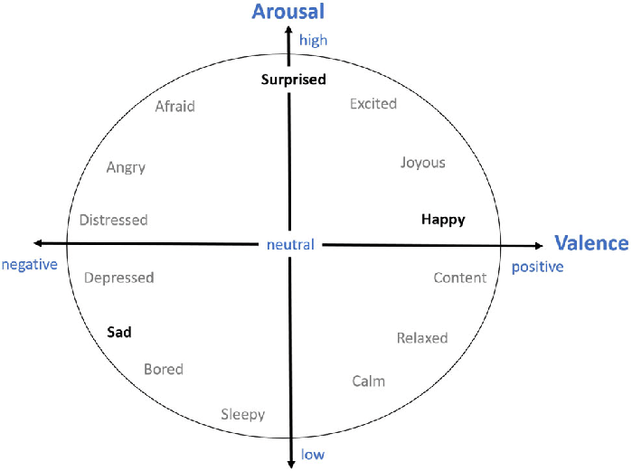
Labeling
4 Classes - Emotions
happy: Valence > 5 and Arousal >5
calm: Valence > 5 and Arousal < 5
anger: Valence <5 and Arousal > 5
sad: Valence < 5 and Arousal < 5
values of arousal and valence in the provided DEAM annotations are in range 1-9, we set a threshold of value 5

Slide 5
Feature Extraction
pyAudioAnalysis
Mid Term – final selection for this dataset due to low deviation
80ms sampling period
Short term with 4 median point to cover high deviation songs
138 features

Slide 6
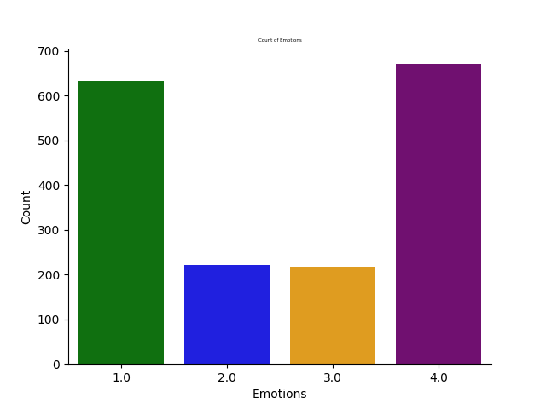
Imbalanced Dataset - Oversampling

Slide 7
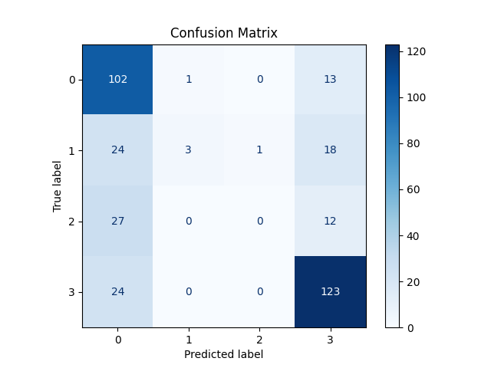
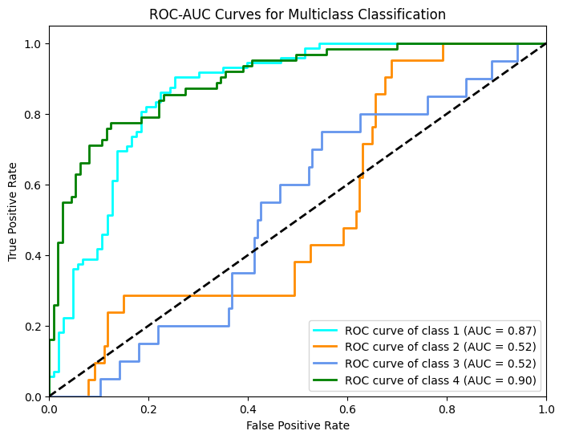
Model fit on original dataset (imbalanced)

Slide 8
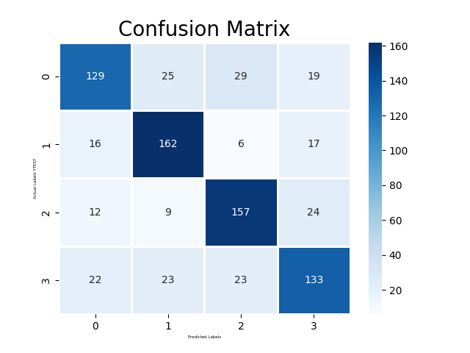
Model fit on dataset after Oversampling (SMOTE)

Slide 9
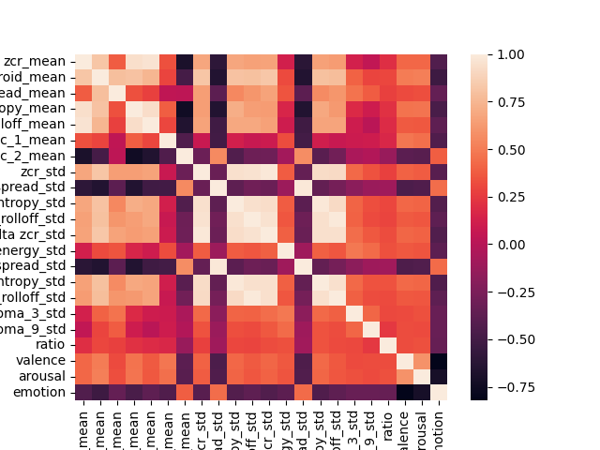
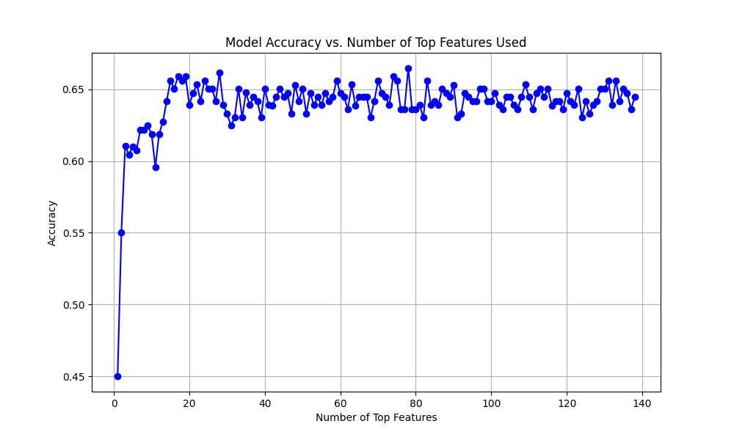
Feature Selection
Delta’s Removal
Correlation Matrix
Random Forest – max accuracy with least features (20)

Slide 10
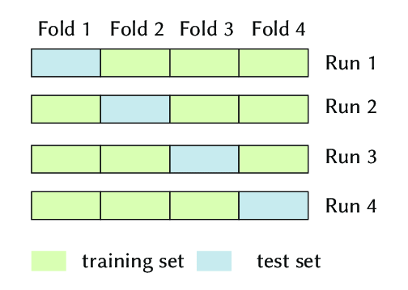
Dataset split - Kfold

Slide 11
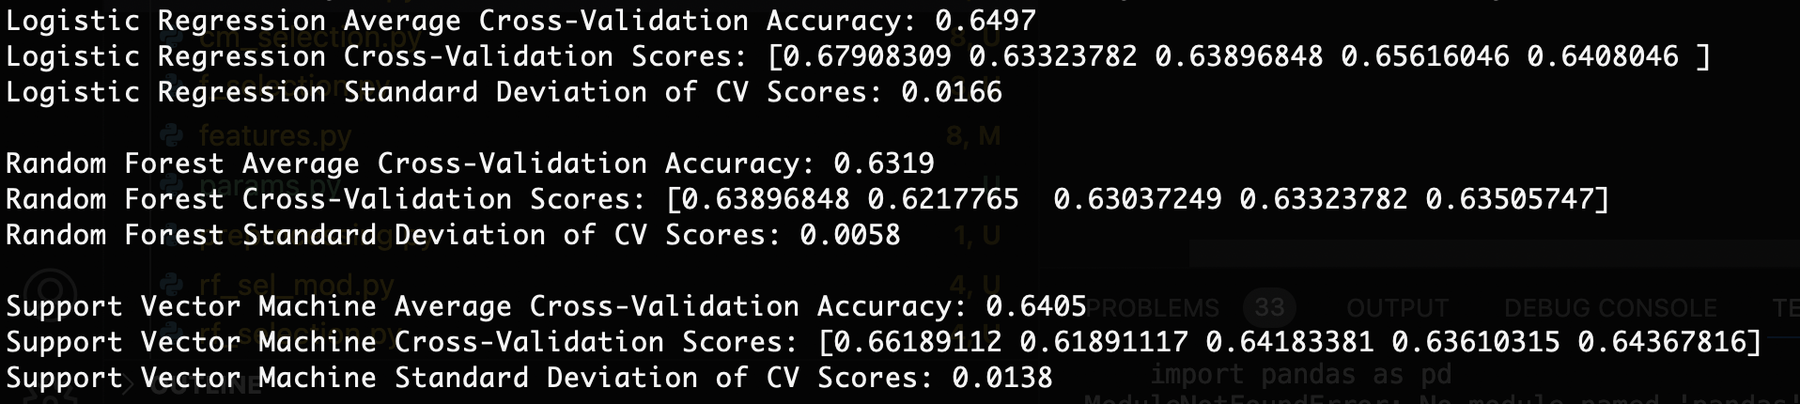
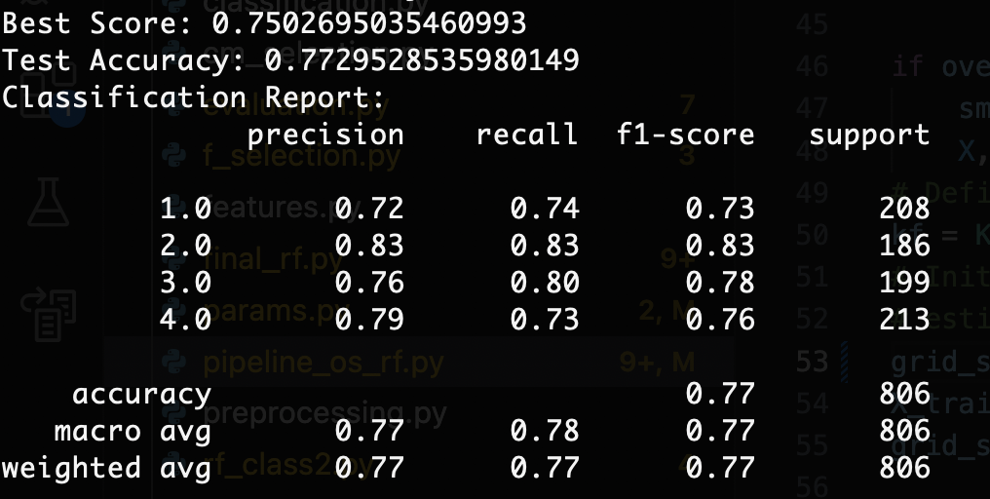
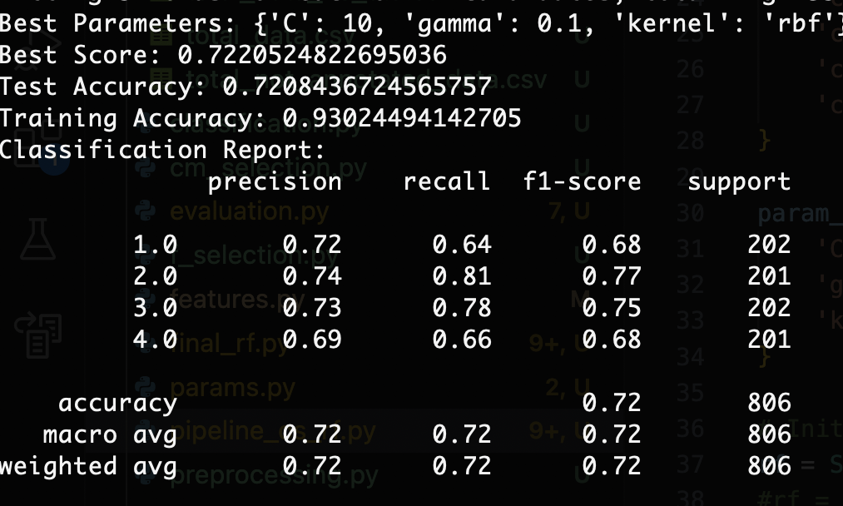
Model Comparison & Results
Best Case on Validation set: Random forest 4/4
Honorable mention: SVC 3/4
GridSearch:

Slide 12
THANK YOU!

